Slide 1
Geological Layer Prediction using logistic regression
Tubagus Moh Reja
Rayhan Ozzy Ertarto

Slide 2

CRISP-DM
Cross Industry Standard Process for Data Mining

Slide 3
Business Problems
PT. XYZ is one of the many mining company in south Sulawesi who want to mine nickel deposit. So the first thing they do is exploration drilling.
Drilling is the stage in mining when you take a soil or rock sample then you analyze it. The data of drilling is used for representation of the mineral content in the ground
Nickel deposit have 3 common layer for representing the minerals. There are Limonite, Saprolite and Bedrock
The problem is human resources like geologist was limitted to make classification of geological layer. So PT. XYZ hire a data scientist to help the geologist to classify the geological layer of nickel deposit.

Slide 4
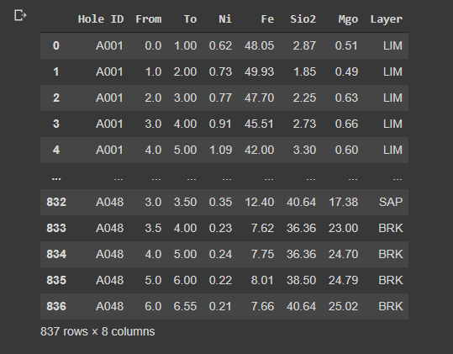
Data Story
Data cointains 8 columns and 837 rows
It has minerals content (numerical), layer (categorical)
Layer is the key column which we will clasify

Slide 5
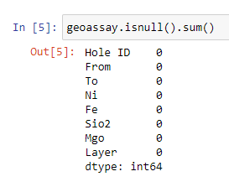
Data Pre-Processing
Let's check if there are missing values in the data set. and analyze the features we want to select and use in the modelling process.

Slide 6
Data Pre-Processing
Let's check if there are missing values in the data set. and analyze the features we want to select and use in the modelling process.

Slide 7
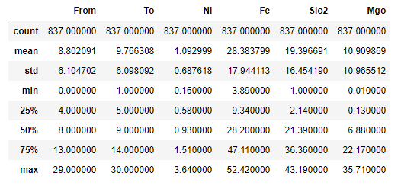
Data Pre-Processing

Slide 8
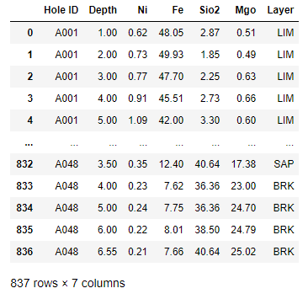
Data Pre-Processing
Let's we drop the 'From' feature since it was have same information with the 'To' feature. and we want to rename 'To' feature into 'Depth' feature.

Slide 9
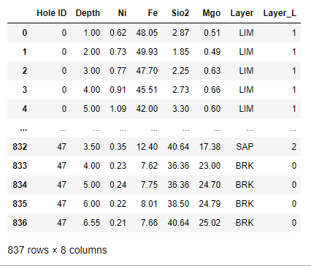
Data Pre-Processing
We need to label all the categorical values using Label Encoder. So the values with convert automatically. As you can see, below the hole ID A001 = 0 so on till Hole ID A048 = 47. and for Layer BRK = 0, LIM = 1, and SAP = 2

Slide 10
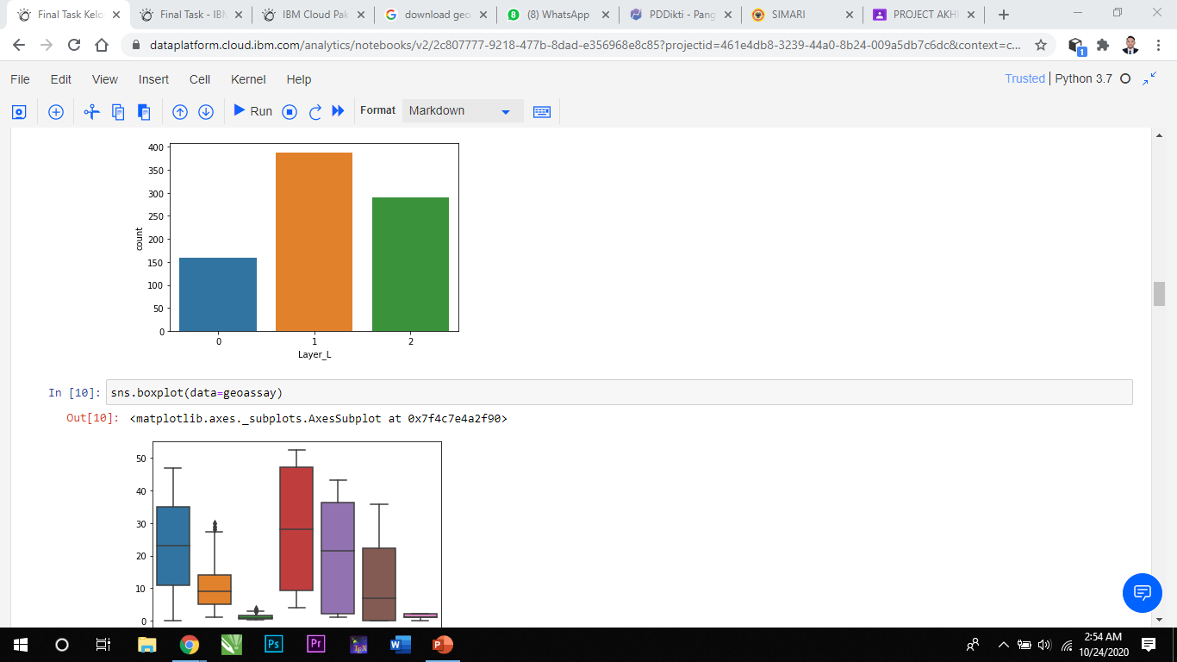
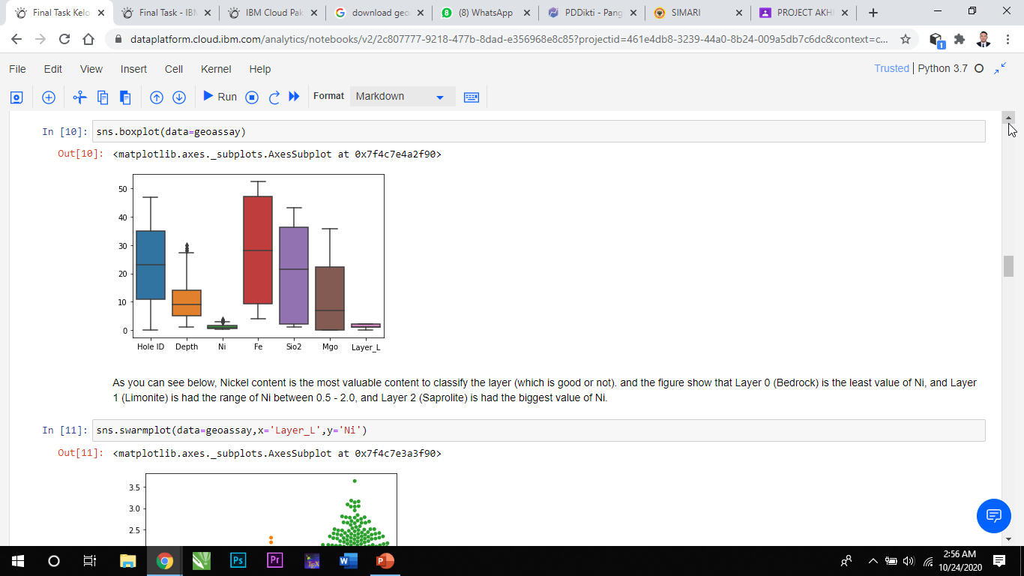
Data Pre-Processing
Since the goal is to classify the geological layer, so we need some data visualization about the geological layer and other feature related.

Slide 11
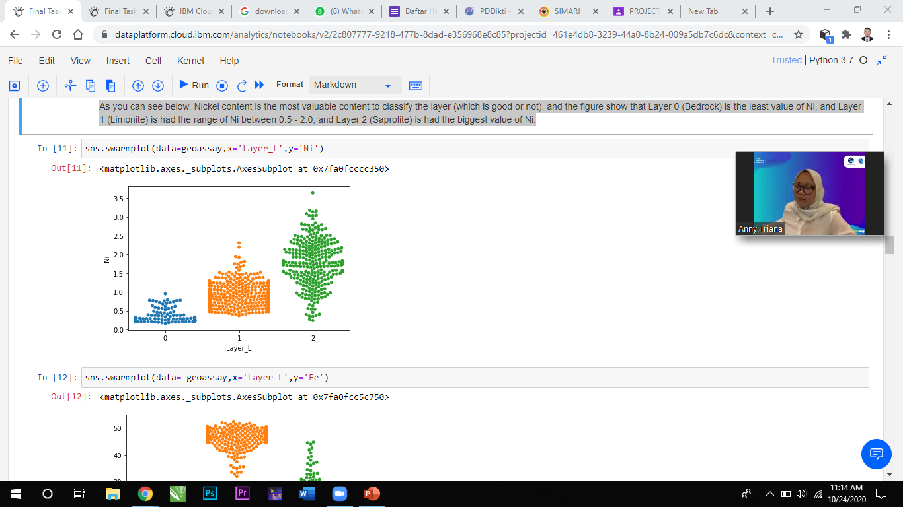
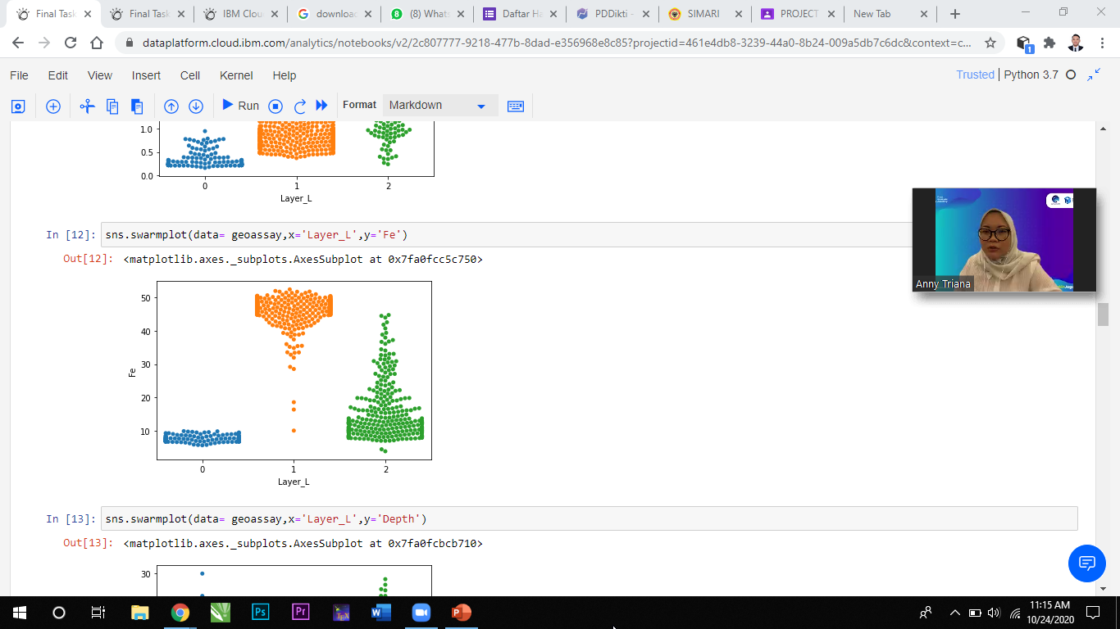
Data Pre-Processing
As you can see below, Nickel content is the most valuable content to classify the layer (which is good or not). and the figure show that Layer 0 (Bedrock) is the least value of Ni, and Layer 1 (Limonite) is had the range of Ni between 0.5 - 2.0, and Layer 2 (Saprolite) is had the biggest value of Ni.

Slide 12
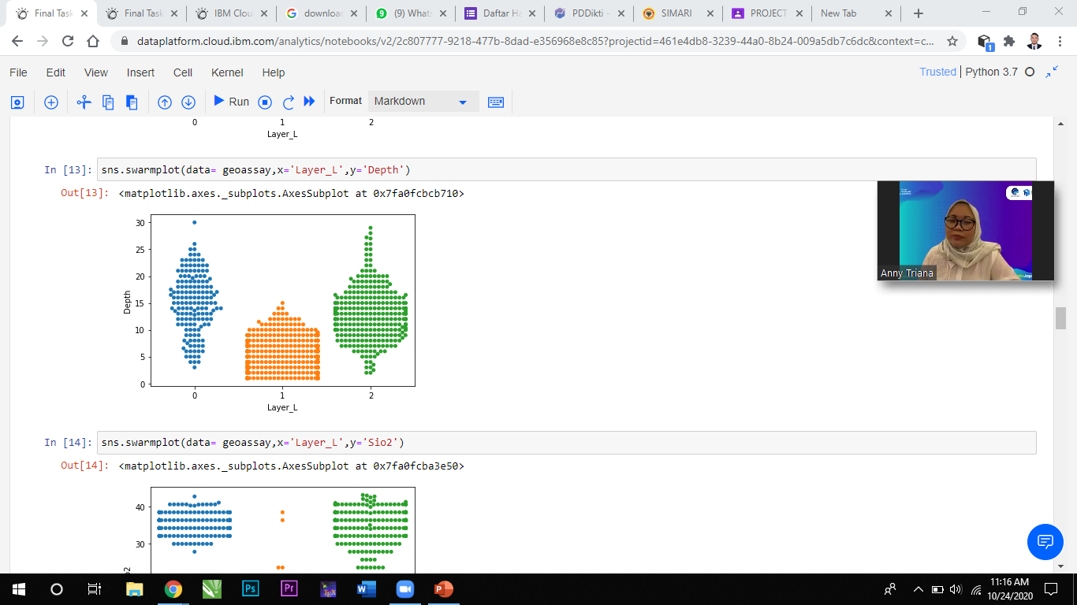
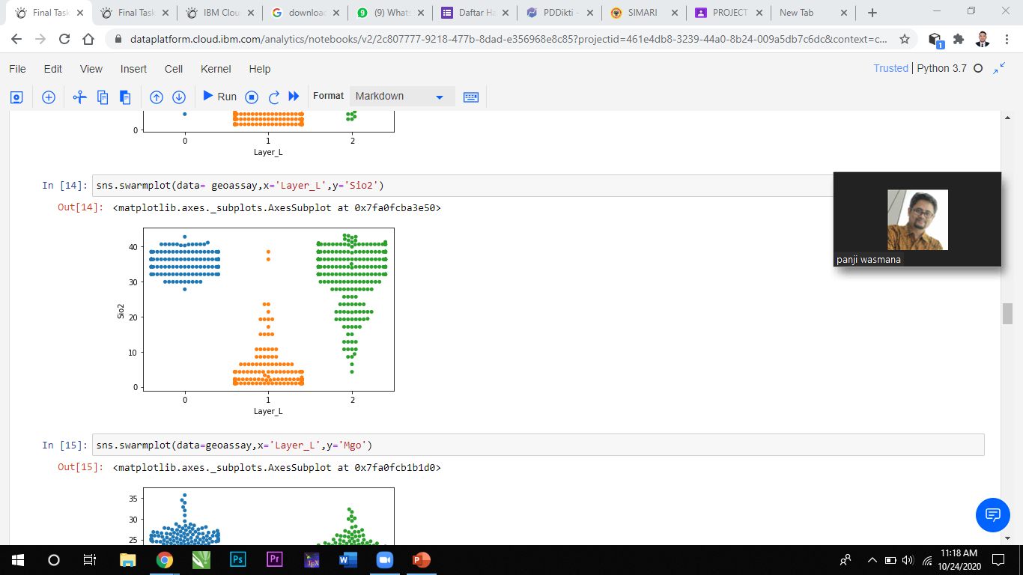
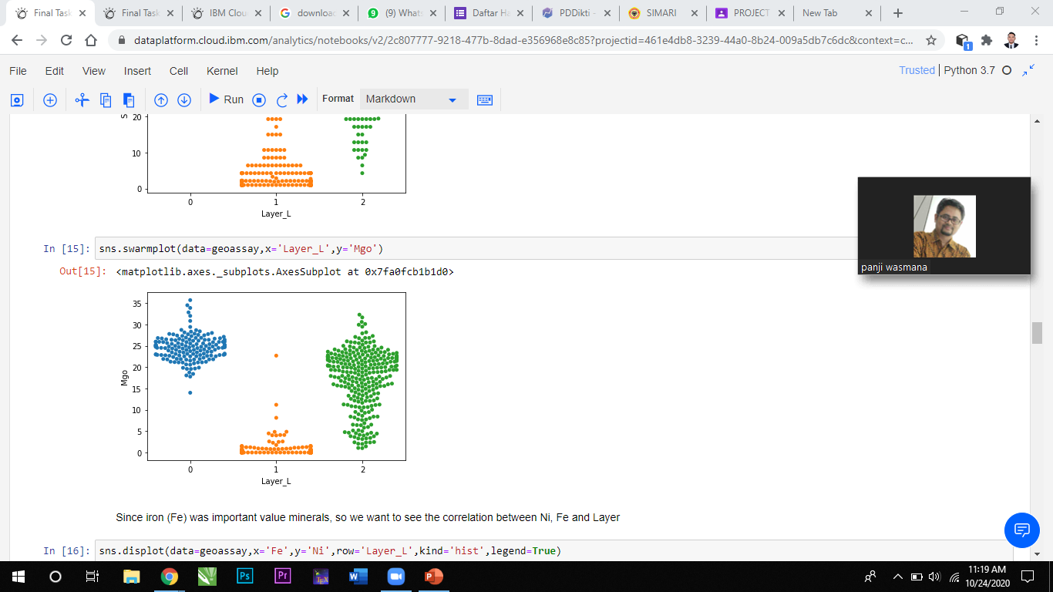
Data Pre-Processing

Slide 13
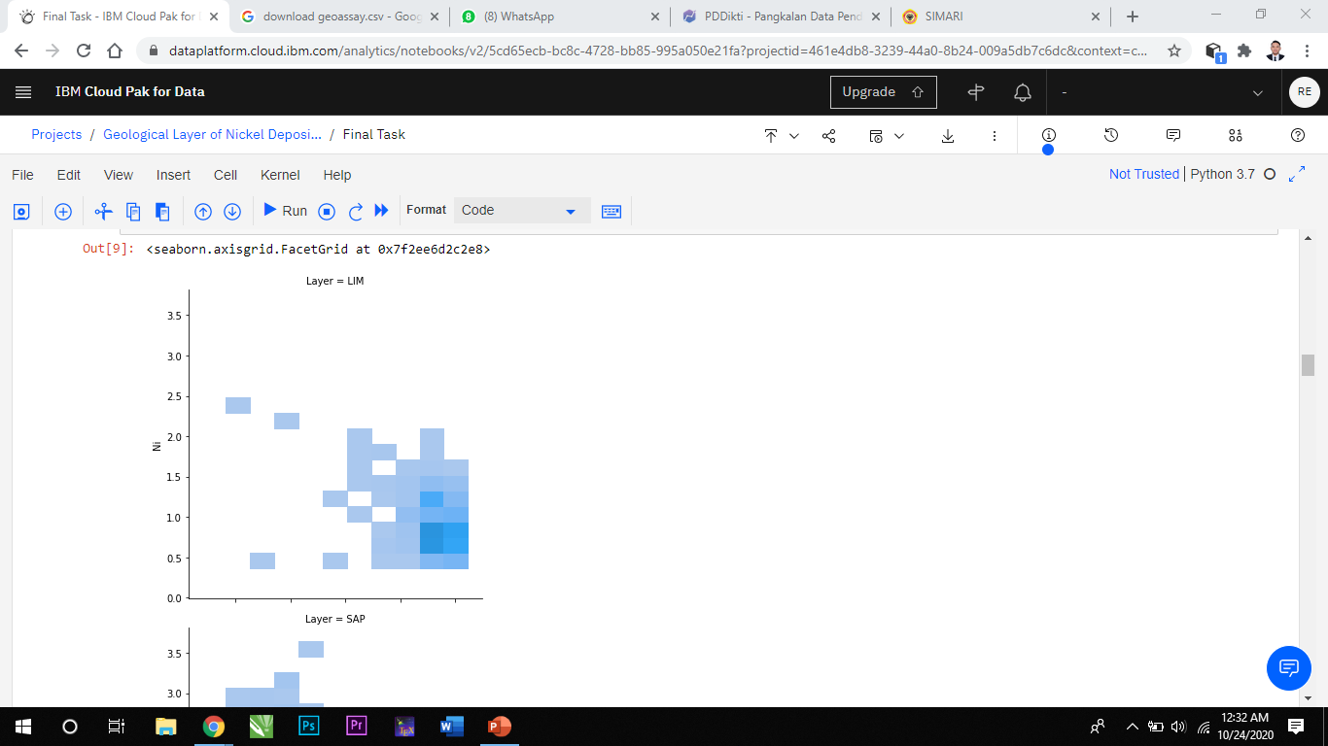
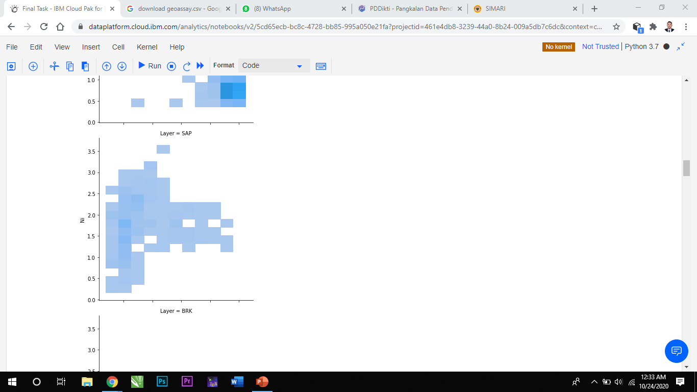
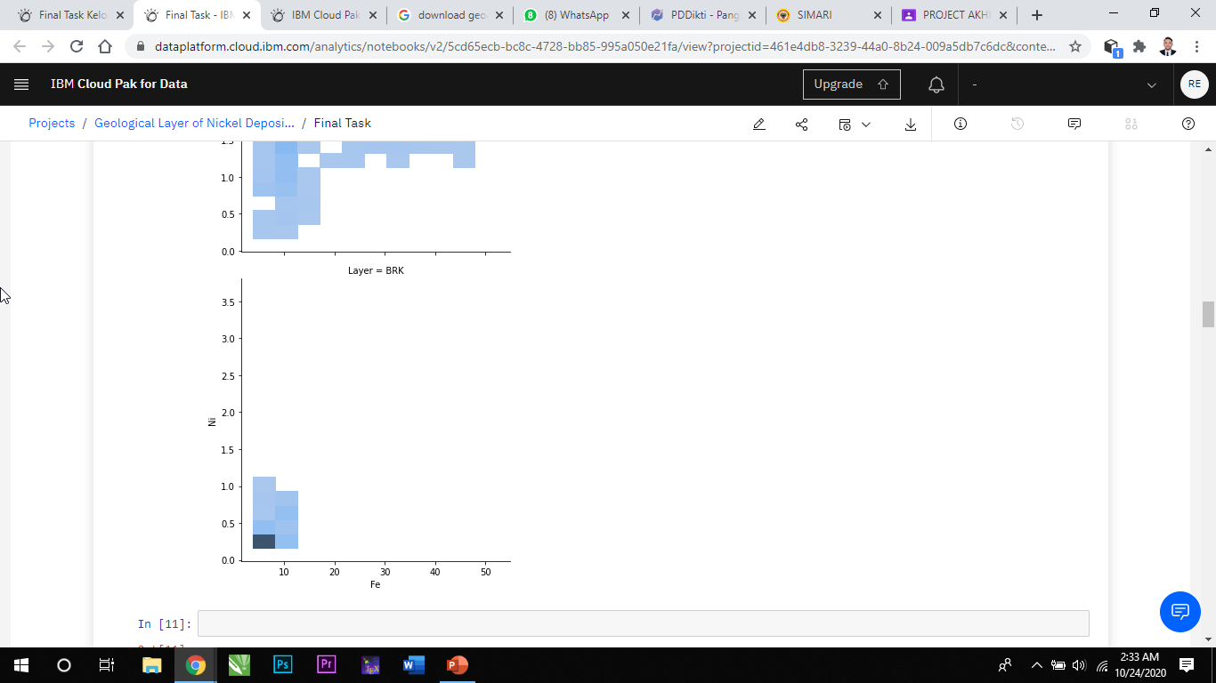
Data Preparation
Since iron (Fe) was important value minerals, so we want to see the correlation between Ni, Fe and, Layer.

Slide 14
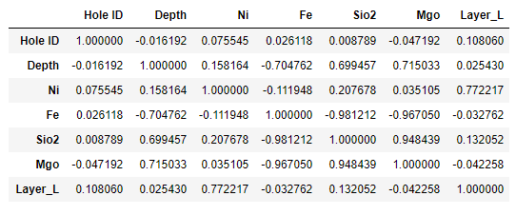
Data Preparation
Pearson Correlation Table

Slide 15
Modeling with Logistic Regression
Logistic Regression is a variation of Linear Regression, useful when the observed dependent variable, y, is categorical. It produces a formula that predicts the probability of the class label as a function of the independent variables.

Slide 16
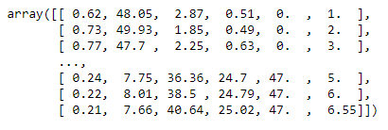
Modeling with Logistic Regression
Set x the independent variables which contains features like Ni, Fe, Sio2, Depth, Hole ID, and Mgo as arrays.

Slide 17
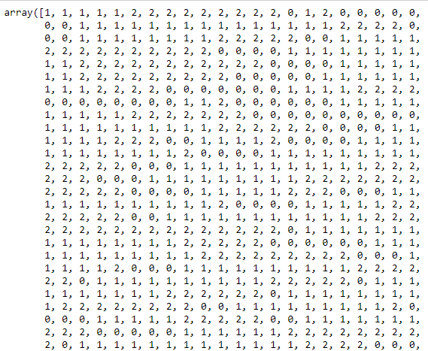
Modeling with Logistic Regression
Set y the independent variables which contains feature Layer as array too.

Slide 18
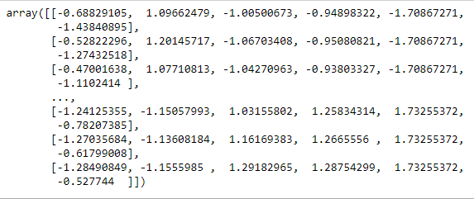
Modeling with Logistic Regression
We will normalize the value of x so it will have a better range of value.

Slide 19
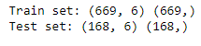
Modeling with Logistic Regression
Now, we will split the data into train data and test data, which test data have proportion 20% of the data.

Slide 20
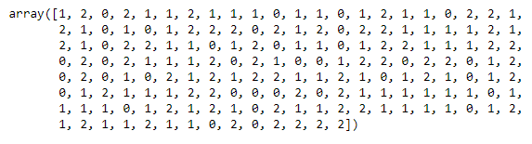
Modeling with Logistic Regression
C parameter indicates inverse of regularization strength which must be a positive float. Smaller values specify stronger regularization.
We use Limited-memory Broyden–Fletcher–Goldfarb–Shanno or LBFGS solver because our data set is small.

Slide 21
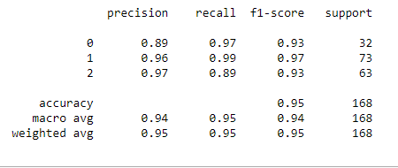
Modeling with Logistic Regression
Classification report

Slide 22
Modeling with Logistic Regression
Based on the count of each section, we can calculate precision and recall of each label:
Precision is a measure of the accuracy provided that a class label has been predicted. It is defined by: precision = TP / (TP + FP)
Recall is true positive rate. It is defined as: Recall = TP / (TP + FN)
So, we can calculate precision and recall of each class.
F1 score: Now we are in the position to calculate the F1 scores for each label based on the precision and recall of that label.
The F1 score is the harmonic average of the precision and recall, where an F1 score reaches its best value at 1 (perfect precision and recall) and worst at 0. It is a good way to show that a classifer has a good value for both recall and precision.
And finally, we can tell the average accuracy for this classifier is the average of the f1-score for both labels, which is 0.97 in our case.

Slide 23
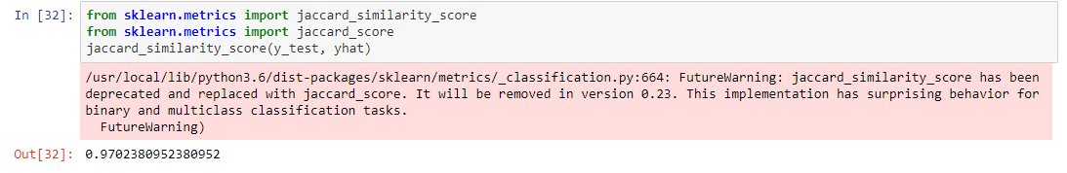
Modeling with Logistic Regression
Evaluation (Jaccard Score)
So we have made the prediction model of yhat. Now we want to evaluate the similarity between y_test and yhat using jaccard similarity score. If the score closer to 1 than our model is good, otherwise it's not good.

Slide 24
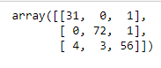
Modeling with Logistic Regression
Confusion Matrix
For double evaluation we will make confusion matrix. Confusion matrix will compare the true value and predicted value of each Layer.

Slide 25
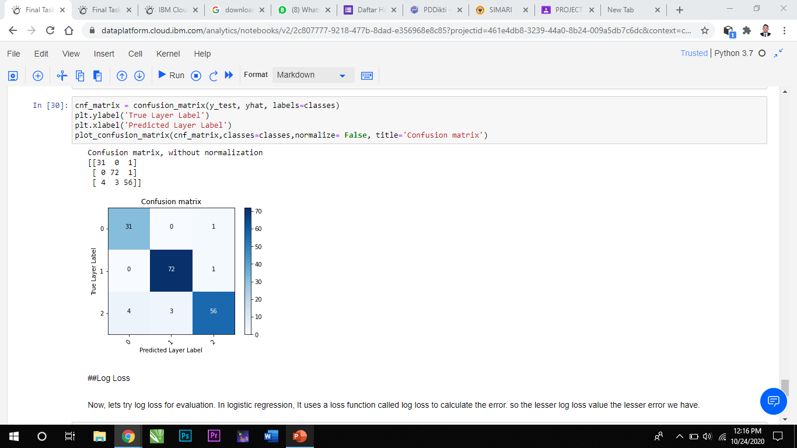
Modeling with Logistic Regression
Now we will visualize the confusion matrix.

Slide 26
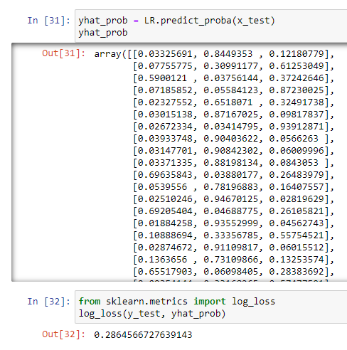
Modeling with Logistic Regression
Log Loss
Now, lets try log loss for evaluation. In logistic regression, It uses a loss function called log loss to calculate the error. So the lesser log loss value the lesser error we have.

Slide 27
CONCLUSION
From the confusion matrix, in the first row, the model we made correctly predict 31 layer as label 0 (which is Bedrock) and wrongly predict 1 layer as label 2 (which is Saprolite). In the second row, the model correcly predict 72 layer as label 1 (which is Limonite) and wrongly predict 1 layer as label 2 (which is saprolite). In the third row, the model correcly predict 56 layer as label 2 (which is Saprolite) and wrongly predict 7 layer as label 1 and 0.
From all of the 168 prediction been made our model was wrongly predict 9 layer. So our model have accuracy or precision of 94.6 % which is very good.

Slide 28
CONCLUSION
Log loss is small which is 0.2864566727639143
Jaccard dimilarity is 0.9464285714285714 Which is good because i’ts closer to 1

Slide 29
NOTEBOOK
https://dataplatform.cloud.ibm.com/analytics/notebooks/v2/2c807777-9218-477b-8dad-e356968e8c85?projectid=461e4db8-3239-44a0-8b24-009a5db7c6dc&context=cpdaas

Slide 30

Thank you

